Slide 1
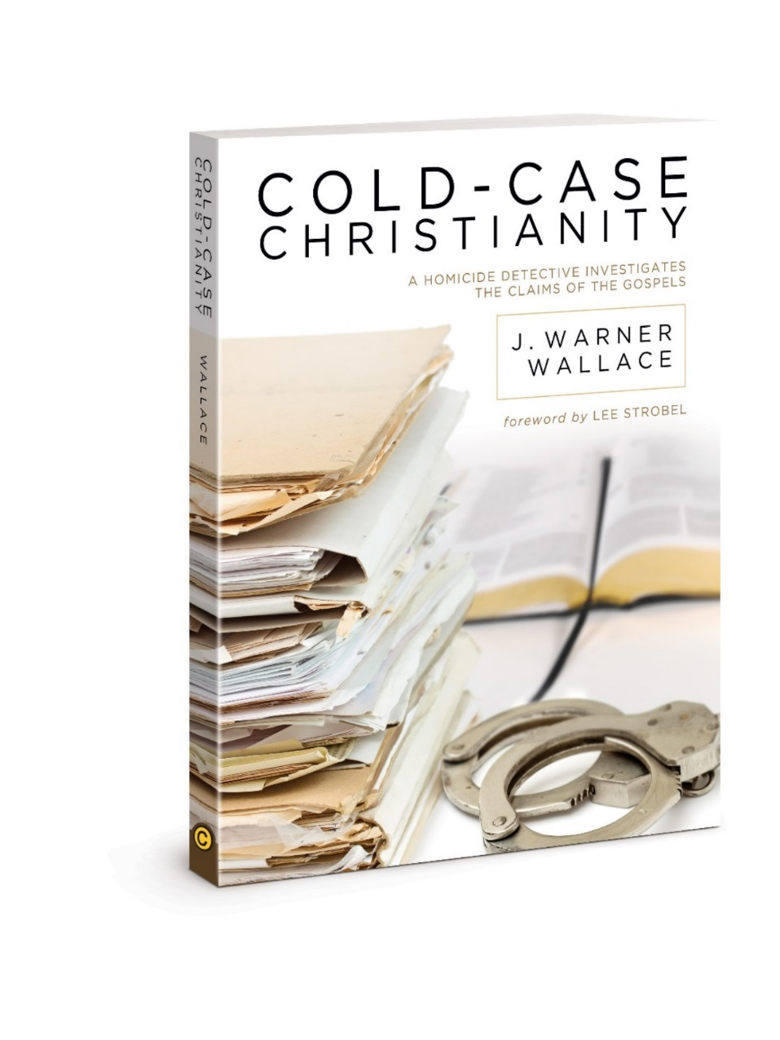

Chapter 13
Section 2
Were + They Honest and Accurate?

Slide 2
So far we covered
Gospel writers were present
Their statements were corroborated
Content to cover in this chapter: Was what they wrote honest and accurate over time? Do we have the same copy of the text that the original authors wrote?

Slide 3
How do we know that our holy books are free from error? Because the books themselves say so. Epistemological black holes of this sort are fast draining the light from our world. —Sam Harris, neuroscientist, speaker, and author of The End of Faith: Religion, Terror, and the Future of Reason
Notes:
We are going to demonstrate that it actually takes more faith to believe the bible is inaccurate

Slide 4
What Critics Have Said
The characters and events depicted in the … bible are fictitious. Any similarity to actual persons, living or dead, is purely coincidental —Comedians and magicians “Penn and Teller”
Notes:
In other words, the claim is that any people or places we identify that are real in the bible are purely coincidental.

Slide 5
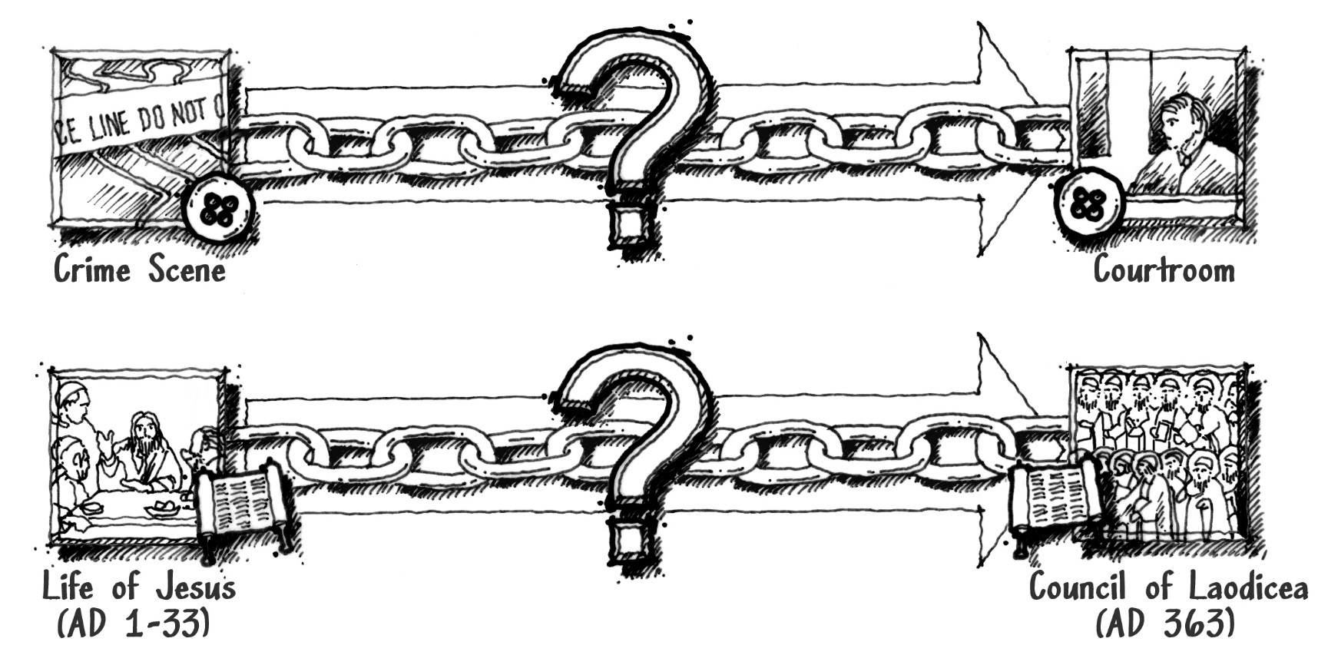
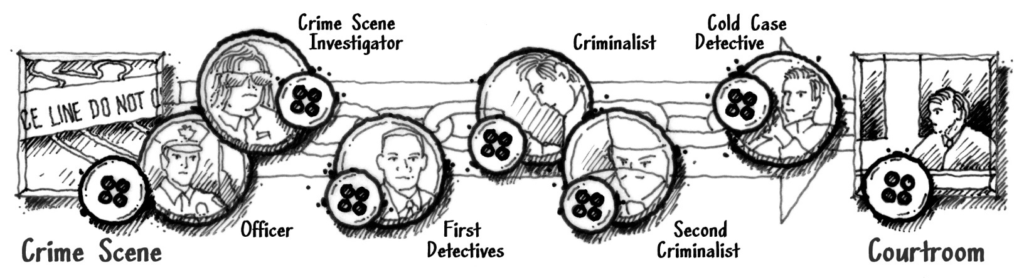
How Do We Know the Evidence In Trial is the Same As the Evidence At the Original Scene?
We Examine the Evidential “Chain of Custody” to See if the Evidence Has Changed Over Time
Notes:
-The accuracy of the bible can be likened to a blurry picture of a button at a crime scene.
-The button is too fuzzy for jurors in court to identify clearly, so we have to rely on the chain of custody to ensure the button evidence is legit
-The chain of custody has to do with the documentation of who handled the evidence and when

Slide 6
How Do We Know the Gospels We Have Today Are the
Same As the original gospel writings?
We will Examine the Scriptural “Chain of Custody” to See if the Gospels Have Changed Over Time

Slide 7
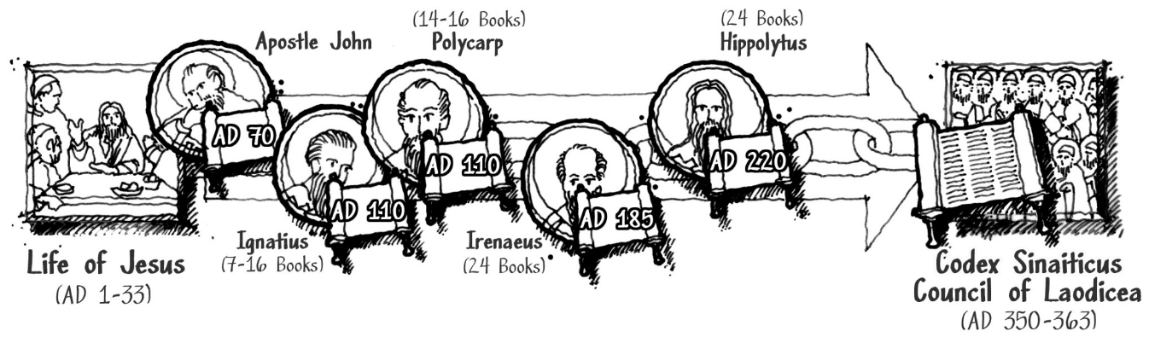
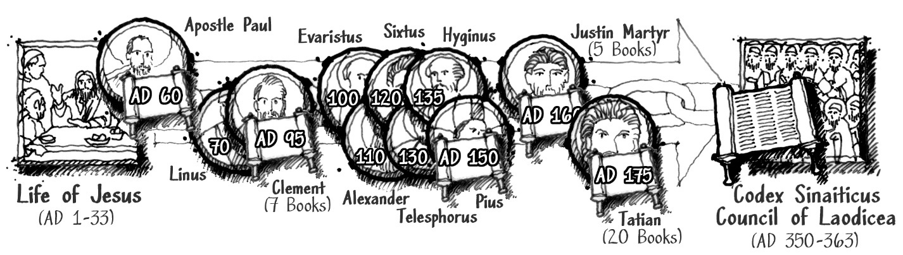
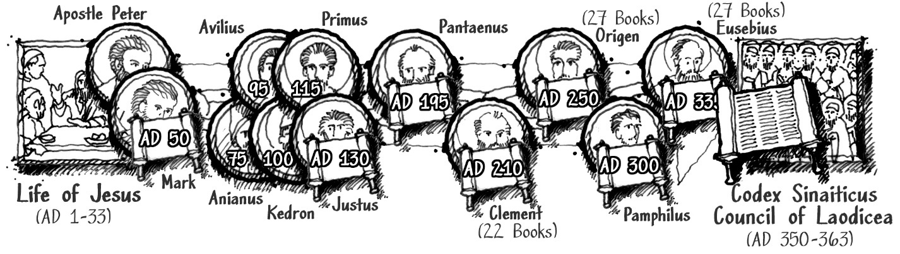
Apostle John - From Asia Minor
Apostle Paul - From Italy
Apostle Peter - From North Africa
Notes:
Top- Apostle John
Middle – Apostle Paul
Bottom – Apostle Peter
And their students

Slide 8
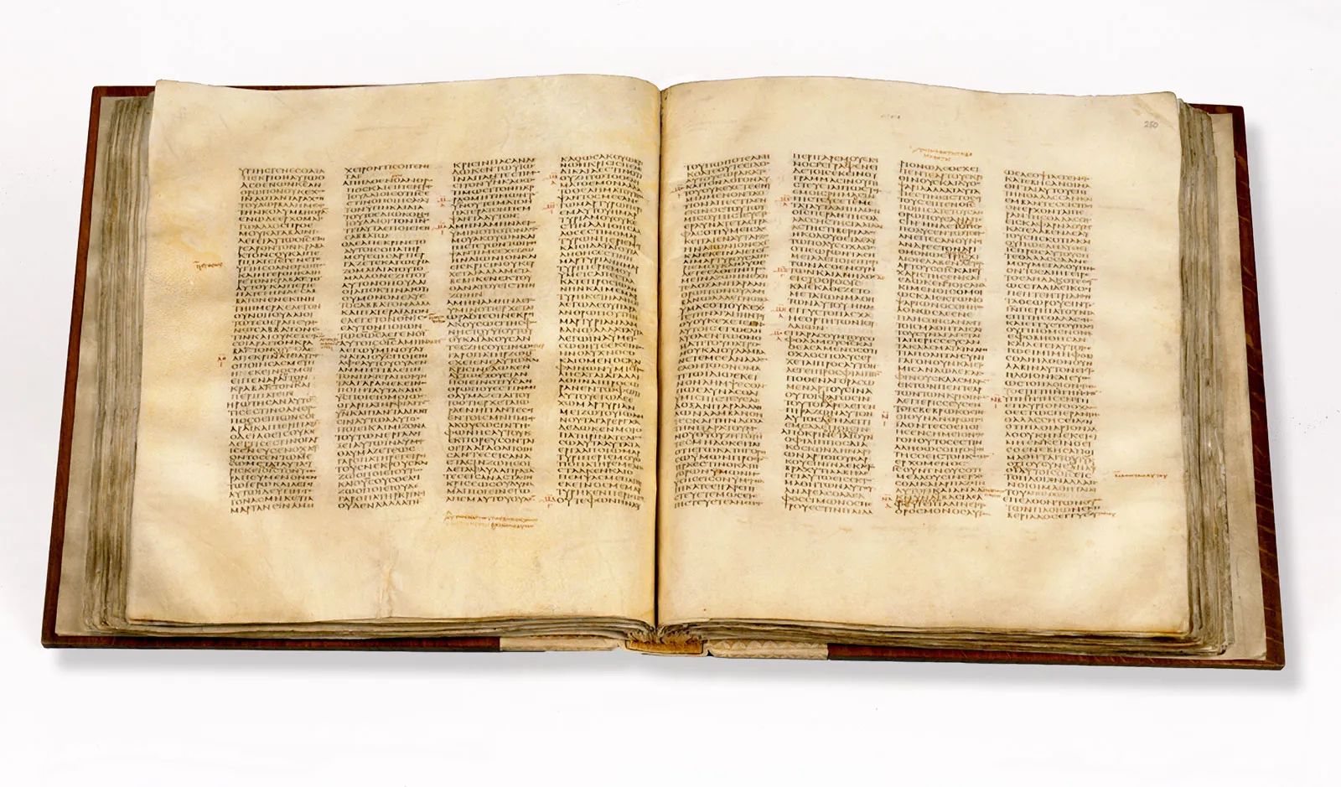
Were Accuracy of Gospels Preserved?
Does the text today say what the original authors wrote?
Oldest complete NT copy (Codex Sinaiticus) Believed to be dated at 350 AD
Notes:
was discovered in the Monastery of Saint Catherine at Mount Sinai. -Constantine Tischendorf observed it and published its discovery in 19th century
------------------------------------------------------------------------ we talked about chain of custody (Chpt 8)

Slide 9
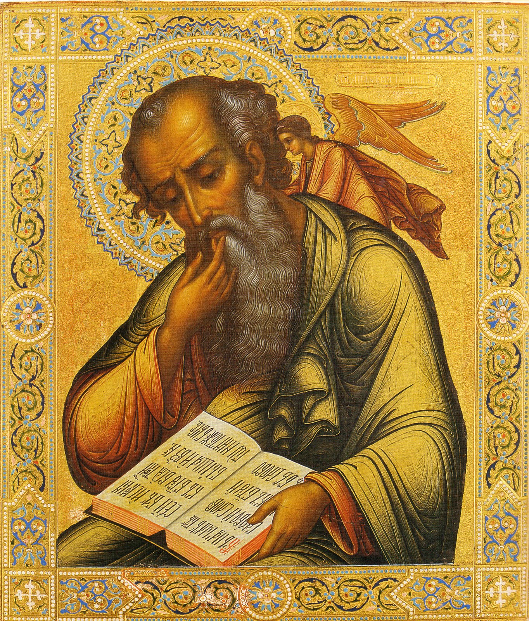
Did the message change?
Let’s follow the chain of custody from apostles to their students
Apostle John (ca. AD 6-100)
Student: Ignatius (ca. AD 35-117) Bishop at Antioch(modern Turkey)
Ignatius quoted (or alluded to) 7 to 16 NT books, including Matt, John, Luke, most Paul’s books
Ignatius’ writings – show that he kept in contact with the apostles.
He wrote as if the scripture we have today was readily available for his readers to reference
Notes:
------------------------------------------------------------------------
The apostle John lived till approximately 94 years old.

Slide 10
Ignatius’ letters
Things we know from reading Ignatius’ letters:
The prophets predicted and waited for Jesus
Jesus was in the line of King David
Was the “Son of God”
Conceived by Holy Spirit
Star announced birth
Came from God the Father

Slide 11
Ignatius’ Letters 2
Baptized by John the Baptist
The “perfect” man
Manifested will & knowledge of God the Father
Taught and had a “ministry” on earth
The source of wisdom and taught many commandments
Spoke the words of God

Slide 12
Ignatius’ Letters 3
Ointment poured on Jesus’ head
Was unjustly treated and condemned by men
Died on a cross
Sacrificed as offering to God the Father
With Pontius Pilate as the government authority
Herod the Tetrarch was king.
Jesus was resurrected
...
Notes:
-had a physical resurrection body
-appeared to Peter and the others after the resurrection
-encouraged the disciples to touch Him after the resurrection
-ate with the disciples after the resurrection
-disciples convinced by the resurrection appearances
-disciples fearless after seeing the risen Christ
Jesus returned to God the Father
-Jesus now lives in us
-we live forever as a result of our faith in Christ
-He has the power to transform us
-Jesus is the manifestation of God the Father
-He is united to God the Father
-He is our only Master and the Son of God
-He is the “Door”, the “Bread of Life,” and the “Eternal Word”
-He is our High Priest, “Lord”, “God”, “Our Savior”, and the way to “true life”. -His sacrifice glorifies us. -Faith in Christ’s work on the cross saves us. -this salvation and forgiveness are gifts of grace from God -Jesus loves the church. We (as the church) celebrate the Lord’s Supper in Jesus’ honor.

Slide 13
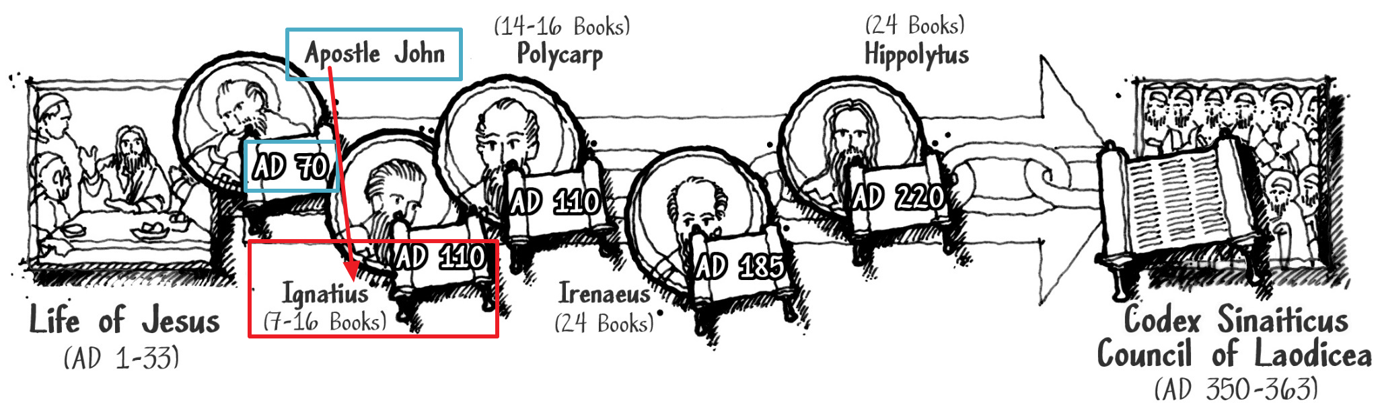
What we have so far in the chain of custody

Slide 14
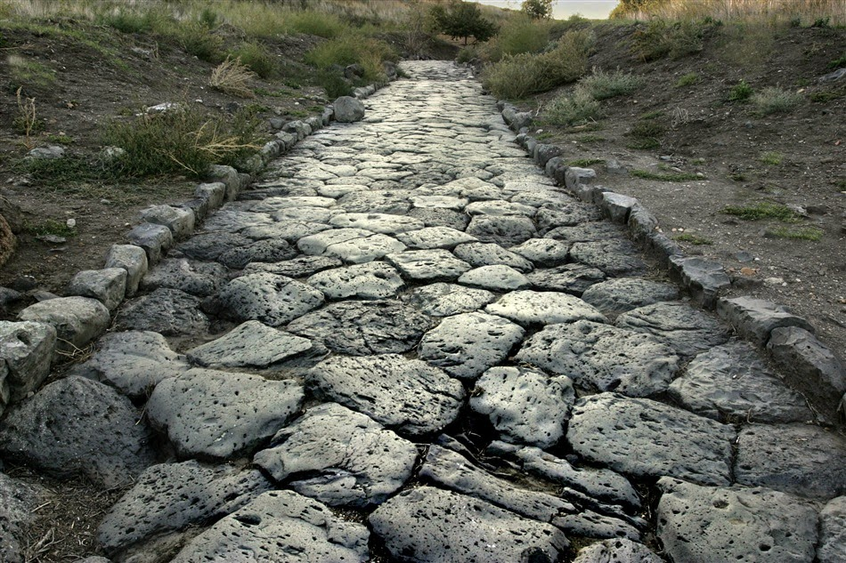
NT claims existed in early history
Since very early in history, the message of the gospels was the same as we have today.
Ignatius’ descriptions of Jesus matched John’s descriptions of Jesus
If the message of the Bible changed, it didn’t change yet at this point in history

Slide 15
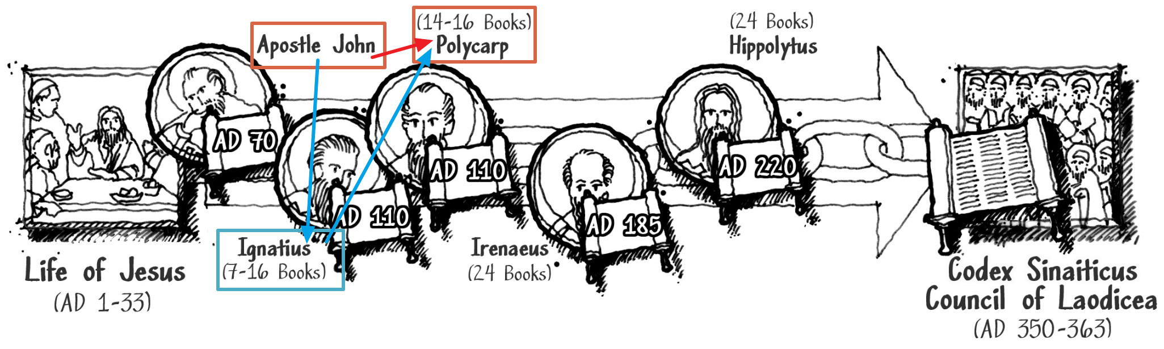
John Taught Polycarp (AD 69-155)
2nd student of John who we found writings of
Friend of Ignatius & student of John
Notes:
-The apostle John no doubt had more than 2 students, so we go off of what writings survived
-We also learn from Irenaeus that John and Polycarp knew and talked with one another
Polycarp eventually becomes bishop of Syrnrna, in modern day Turkey

Slide 16
Polycarp’s letter to Philipi
AD 100 to 150
Shows familiarity with apostles and Ignatius
Content consistent with Ignatius’ letters
Wrote about apostle Paul’s involvement with Phillipian church
He reminded the church at Philipi to live up to NT teaching in the “sacred scriptures” and quoted the book of Ephesians

Slide 17
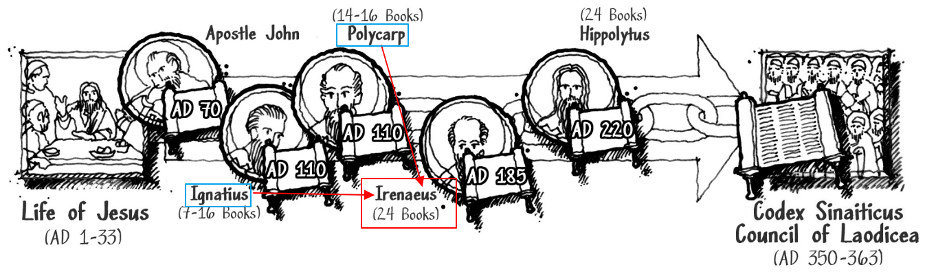
Ignatius + Polycarp
Taught Irenaeus (AD 120-202), continuing the chain of custody for the gospel accounts

Slide 18
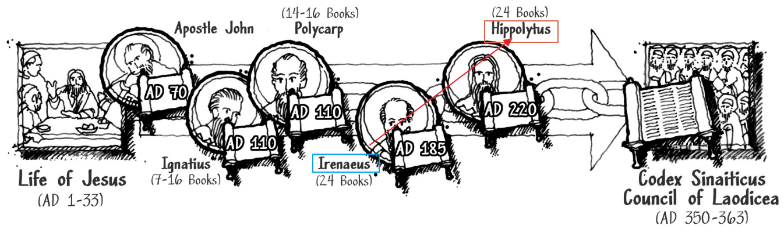
Irenaeus
Became bishop of modern day Lyons, France
Wrote a book “Against Heresies”
Identified up to 24 NT books as scripture
Student of Irenaeus: Hippolytus(AD 170-236)
Notes:
------------------------------------------------------------------------
3.)including Matthew, Mark, Luke, John, Acts, Romans, 1+2 Cor, Galatians, Ephesians, Philippians, Colossians, 1+2 thessalonians, 1+2 Timothy, Titus, 1 Peter…
Lugdunum in Gaul

Slide 19
Hippolytus
Born in Rome
Eventually opposed Roman bishops who changed beliefs to accommodate “pagans”
First “antipope” in Christian history
Wrote “Refutation of All Heresies”
Identified up to 24 NT books as scripture
No writings of Hippolytus students found/survived
Notes:
-persecuted under Emperor Maximus Thrax and exiled to Sardina, where he most likely died in the mines

Slide 20
Origen of Alexandria
Claimed to be a disciple of Hippolytus
But no concrete, corroborating evidence to confirm that, so we didn’t include Origen on our chart

Slide 21
Chain of custody so far
John’s disciples consistently kept the same message
Notes:
We have two other chains of custody to follow which cover a broader time period

Slide 22
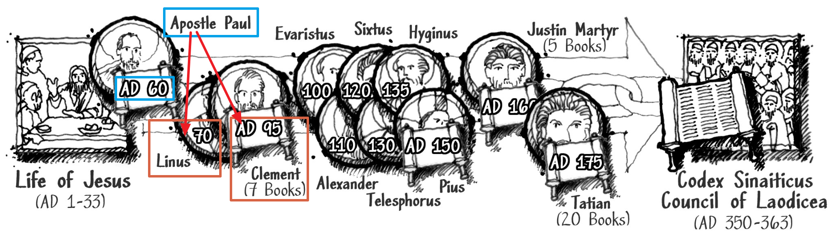
Apostle Paul’s students
Paul quoted Luke
Taught Linus and Clement of Rome
From secular history, we know Linus became the pope of Rome after Peter and Paul’s deaths -Paul mentions Linus’ + his parent “Claudia” (2 Tim 4:21)
Notes:
-Irenaeus named Linus as one of Paul’s coworkers
-In 2nd Timothy, Paul calls Linus a “fellow coworker in the gospel”
-Paul also mentions Clement of Rome as a “coworker” in Phil 4:3
------------------------------------------------------------------------
1.) 1 Timothy 5:17-18, 1 Cor 11:23-35.
-Paul names Linus in 2 Timothy 4:21 as a fellow coworker in the gospel, including Claudia

Slide 23
Clement of Rome
AD 80-140 wrote “The First Epistle of Clement to the Corinthians” –earliest manuscript compared to other NT books -encouraged Corinthian church to holy living
He quoted or alluded up to 7 NT books
He talked about the chain of custody from Jesus to the apostles, to his own second-generation readers
Clement’s description of Jesus matches Ignatius + Polycarp

Slide 24
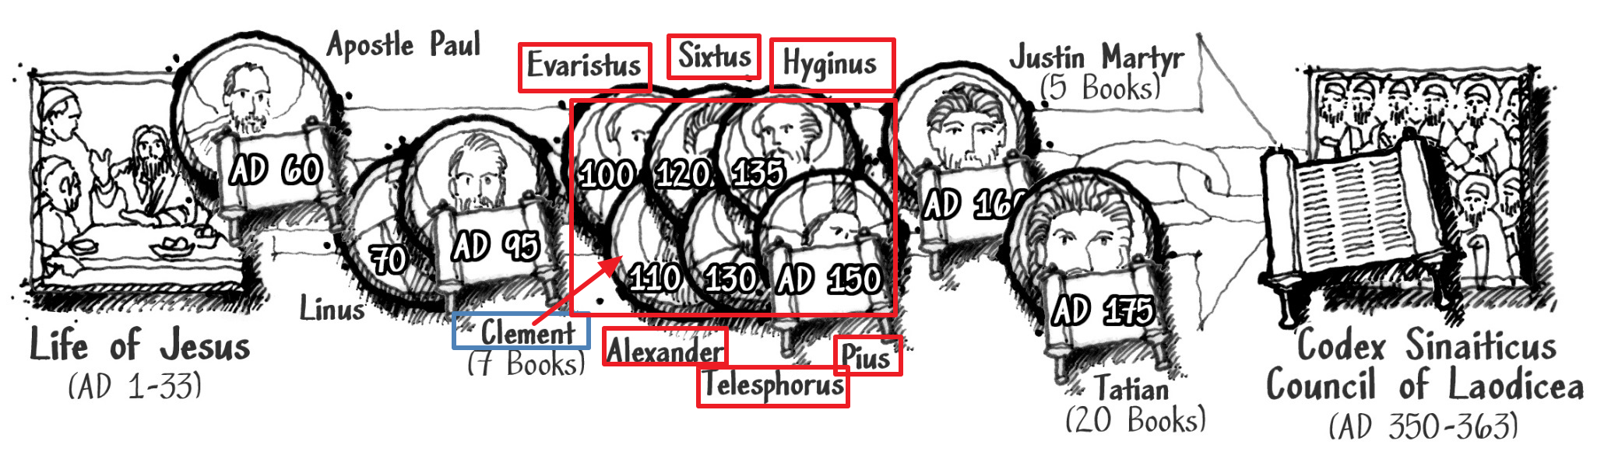
Successor bishops of Linus and Clement of Rome
Clement → Evaristus → Pius → Alexander I
→ Sixtus I → Telesphorus → Hyginus → Pius I
(AD 109-154)

Slide 25
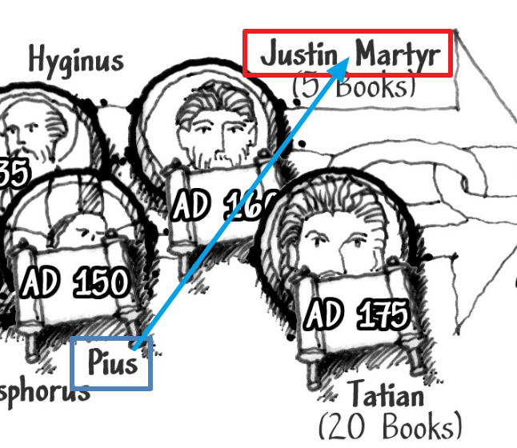
Justin Martyr
One of the earliest Christian apologists
Raised a Greek before conversion
Taught Christian doctrine in Rome when Pius I was bishop in Rome
Wrote “First Apology”, “Second Apology”, “Dialogue with Trypho”, where Justin quoted or alluded to NT books
Wrote about the early bishops and popes of Rome
Notes:
4.)NT books: Matthew, Mark, Luke, John, Revelation
5.)Justin Martyr mentions how the early bishops and popes recognized the importance of the eyewitness accounts of Jesus

Slide 26
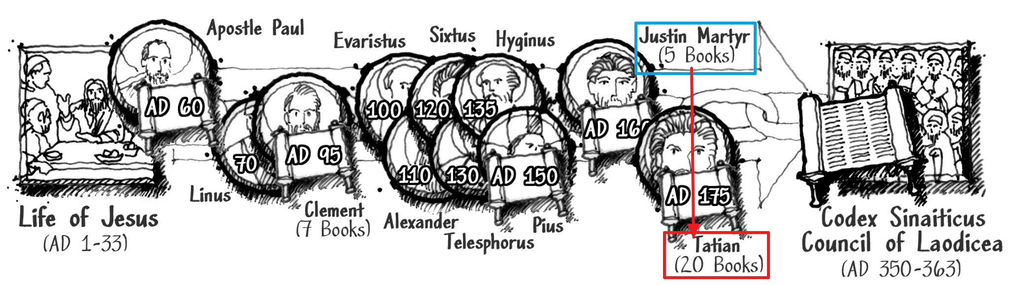
Tatian the Assyrian (AD 120-180)
Student of Justin Martyr who converted
Introduced teachings that forbade marriage and eating meat, but had writings that recognized the existence of the 4 main gospels, Paul’s letters, and Acts
Notes:
His writings were “Diatessaron” (a biblical paraphrase) and “harmony”(where he tried to put all the 4 main gospels into one document)
Tatian’s attempt to rewrite the gospels into what he wanted them to be were not successful.
This is an example showing how we were able to sort out folks who tried to change the gospels

Slide 27
The rest of Paul’s students?
History does not give precise information about the next link in the chain of custody from the Apostle Paul and his students

Slide 28
Apostle Peter’s students
Peter (1 BC-AD 67) is believed to be one of the oldest of Jesus’ disciples
John Mark – cousin of Barnabas -Acts 12:12-14
Peter calls Mark “my son” – (1 Pet. 5:13)
known as “John Mark” and “Mark”
Mark started church in Alexandria
Also was a travel companion of Apostle Paul
Mark wrote gospel of Mark with Peter as the eyewitness
Notes:
------------------------------------------------------------------------
In chapter 5, we went through the evidence that supports the claim that Mark authored Peter’s eyewitness account in the gospel of Mark

Slide 29
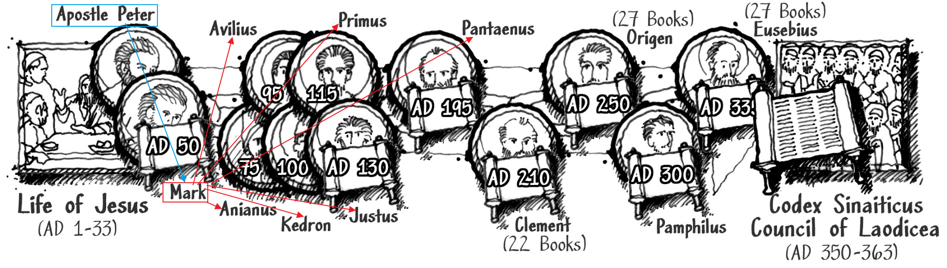
Mark’s Students
Anianus (AD ?-82) Avilius (AD ?-95) Kedron (AD ?-106) Primus (ca. AD 40-118) Justus (AD ?-135) Pantaenus (AD 195)
Became bishops of Alexandria and led churches in North Africa
Notes:
They preserved the eyewitness accounts

Slide 30
Pantaenus
One of Mark’s students
Director of Catechetical School of Alexandria
An ex-stoic philosopher who converted
Wrote about traveling east (possibly as far as India), citing how folks there were using the gospel of Matthew, written in Hebrew

Slide 31
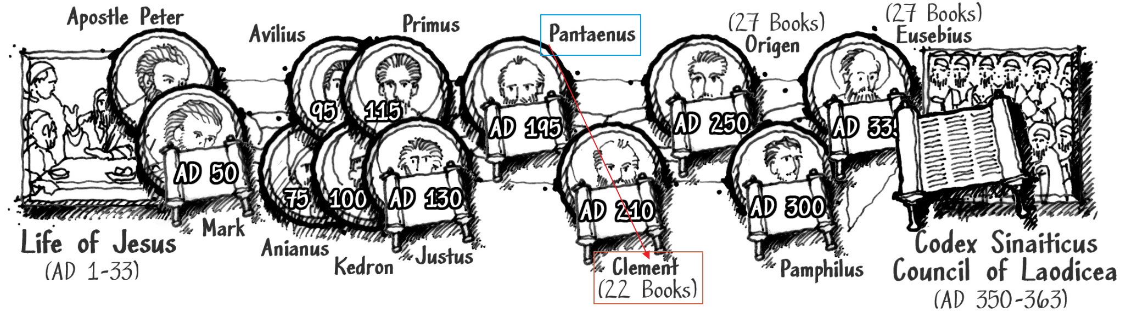
Clement of Alexandria (ca. AD 150-215)
Was a student of Pantaenus
Also taught at Catechetical School of Alexandria
Notes:
Wrote 3 books addressing Christian morality and conduct. Quoted or alluded to all NT books except a few
------------------------------------------------------------------------
4.)NT books not referenced were Philemon, James, 2 Peter, 2 John, and 3 John
Wrote “Protrepticus”, “Paedagogus”, and “Stromata”, addressing Christian morality and conduct. Quoted or alluded to all NT books except a few
Clement of Alexandria’s original name was Titus Flavius Clemens

Slide 32
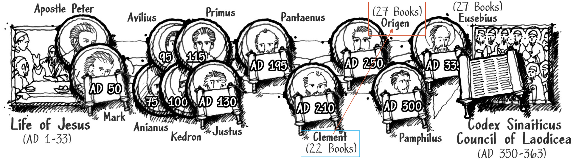
Origen (ca. AD 185-254)
Was a student of Clement of Alexandria
Also taught at the same school
Notes:
Wrote commentaries for nearly every book of the Bible and quoted all NT books we have today
Did express hesitation about James, 2 Peter, 2 John, and 3 John, but included them in his list of reliable eyewitness documents

Slide 33
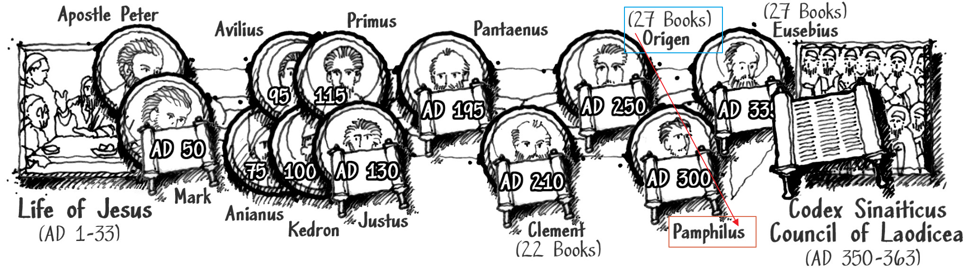
Pamphilus of Caesarea
Origen was from Alexandria and fled to Caesarea Maritima after persecution
Pamphilus (?AD - ?AD) was also from Alexandria and was a student of Origen
Notes:
Pamphilus wrote “Apology for Origen” – accepted eyewitness accounts as legit as passed on by Origen

Slide 34
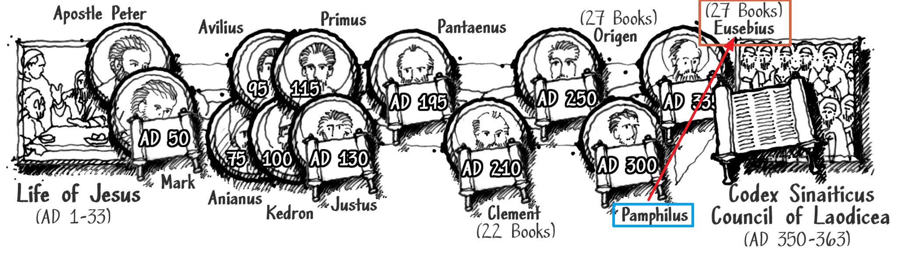
Eusebius
Eusebius of Caesarea (ca AD 263-339) – student of Pamphilus
Documented Pamphilus’ career in a writing: “Vita”
Notes:
Wrote “Church History”, of which much survived to this day.
Identified 26 NT books as scripture
4.)less-strongly affirmed James, Jude, 2 Peter, 2 John, and 3 John

Slide 35
Peter’s students
Chain of custody of the scriptures from Peter to Eusebius
Notes:
Only about a 20 year gap between Eusebius and the council is not bad at all

Slide 36
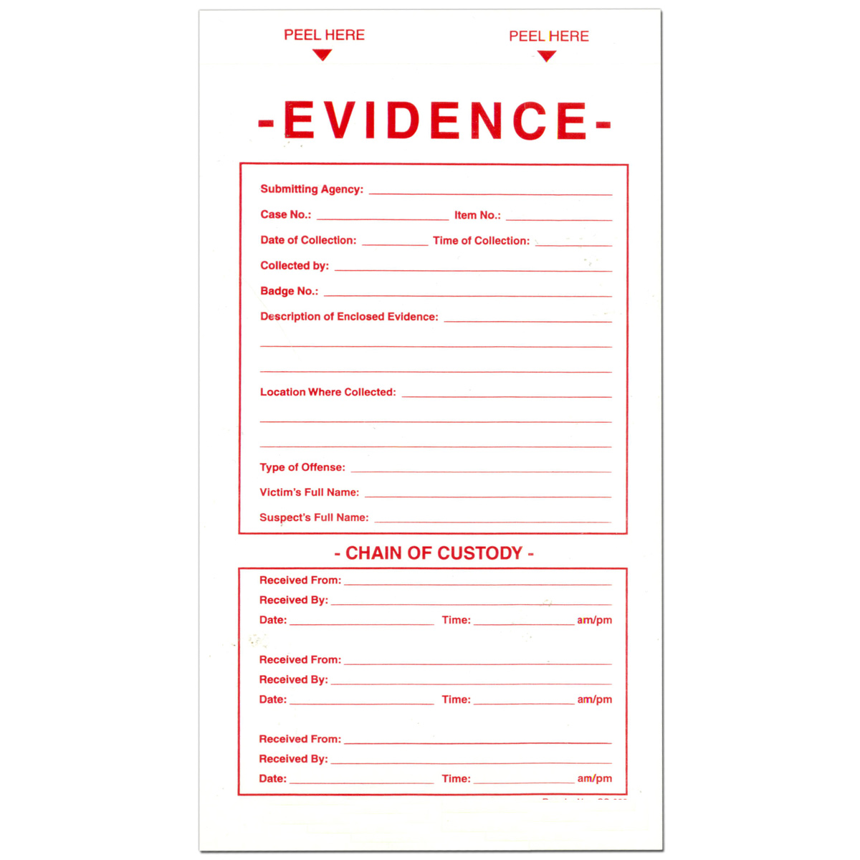
Council of Laodicea
Publicly identified a cannon of writings to be considered as scripture based on their analysis of the chain of custody
The first known public testing of the gospel accounts’ chain of custody
The chain of custody identified texts tied to the authority of the apostles

Slide 37

What if they didn’t exist?
If the main Christian eyewitness account documents about Jesus were lost to history, would we still have enough to learn the truth about Jesus?
Yes, even If we relied on the writings of Ignatius, Polycarp, and Clement alone

Slide 38
Even without the Bible...
The early church fathers of the 2+3rd centuries quoted the New Testament at least 36,289 times.
Counting all early church fathers, we have one million citations of the New testament
You can read nearly the entire New Testament from their quotations alone.
Notes:
------------------------------------------------------------------------ Pg 228 of “I Don’t Have Enough Faith to Be an Atheist” book

Slide 39
From non-canonical sources
We would still know that Jesus was -Jesus was predicted by OT prophets
-conceived of Holy Spirit as only begotten Son of God
-born of the virgin Mary
-announced with a star
-came forth from God and manifested God’s will and knowledge

Slide 40
Non-canon writings
-baptized by John the Baptist
-Lived a humble, perfect, and sinless life
-spoke the words of God
-taught many divine truths
-anointed with oil
-unjustly treated, condemned, whipped, and crucified
Notes:
-execution took place under Pontinus Pilate and reign of Herod the Tetrarch
-Jesus death was payment for our sin debt
-Jesus proved divinity with resurrection
-Appeared to Peter, and other disciples
-Jesus is the “door”, “Bread of Life”, “Eternal Word”, “Master”, “savior”, “Master”, “Guardian”, “Helper”, “Refuge”, “Lord”
-Jesus possesses eternal glory and majesty
-all creation belongs to Him and is subject to Him
-Jesus will judge the living and the dead
-Jesus is God

Slide 41
That was what 1st century students believed
Jesus of Nazareth was not a late invention of someone’s imagination
The earliest students of the apostles believed the same things we have in our current bible cannon.

Slide 42
How was scripture preserved?
No one knows for sure how scriptures preserved
But we have some reasonable possibilities
Paul and Peter described each others letters as scripture
Jewish tradition of record keeping
Deut 31:24-26 references scribes (Sopherim)
Masoretes – used meticulous statistics and notations at ends of their writings to indicate accuracy levels of a text
Dead Sea Scrolls (from 100 BC) showed how accurate Masoretes were
Notes:
2.)Paul described Luke’s gospel as Scripture (1 Tim. 5:17–18), and Peter also described Paul’s letters as Scripture (2 Pet. 3:15–16).
4.)Moses told the document keepers to keep a copy of the Book of the Law and put it next to the ark of the covenant
5.)dead sea scrolls had a complete copy of Isaiah, and much of the old testament. The 5% of differences in the scripture we have today are attributed to small differences such as “favor” vs. “favour”
-If converted Jews had a tradition of meticulous scripture copying that was passed on, that is a reasonable method for how scripture was preserved over time.

Slide 43
Back to the skeptics
Ignatius, Polycarp, and Clement didn’t quote scripture precisely
Paraphrasing NT or OT scripture is not reasonable evidence that they did not exist at the time
Even with paraphrasing, the same Jesus is being described

Slide 44
Corruptions in the scriptures?
How can we trust the scriptures are accurate when there have been obvious insertions/corruptions found in texts?
Textual Criticism – 1000’s of manuscripts to compare with to find corruptions
Compare to Herodotus’ “The Histories in the fifth century BC” that only has 8 manuscripts
Notes:
3.)Textual Criticism – is a process that allows us to identify late additions because we have so many other copies to compare to, allowing us to construct the original message with a high degree of confidence.

Slide 45
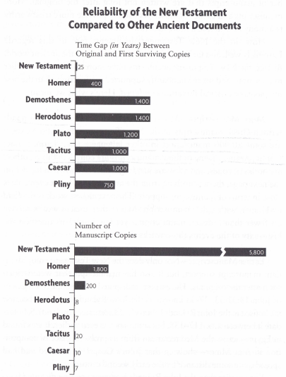
Reliability of New Testament compared to other ancient documents.
Little time between Jesus and manuscripts
# of manuscripts tower over any other ancient literature
Notes:
-For the Time Gap:: The closest manuscript found to the time of Christ was only 25 years from when Christ ascended.
---------------------------------------------------------------- Pg 226 of “I Don’t Have Enough Faith to Be an Atheist” book

Slide 46
How accurate is the New Testament reconstruction?
about 200,000 errors in the New Testament manuscripts, over ~5,700 manuscripts where a variant spelling of one letter counts as 2,000 errors since it has 2,000 manuscripts.
vast majority are strictly grammatical in nature
Result? 98.33% to 99.5% accuracy compared to the original.
No Christian doctrines affected by the .5%
No other ancient document as well authenticated

Slide 47
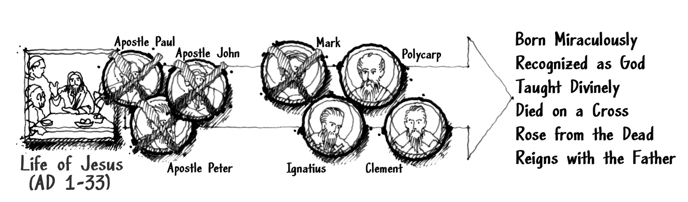
The Gospels We Have Today Have Not Been Altered Over Time
Notes:
What we learn from the apostles’ students is the same thing the apostles taught, meaning that if we didn’t have the bible today, we would still know the truth about Jesus

Slide 48
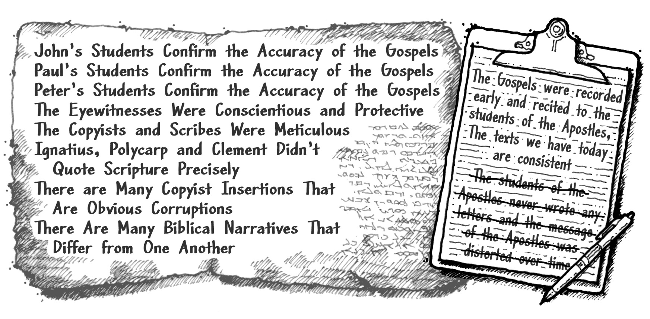
The Gospels Pass the Third Test
Notes:
We followed the evidence for the most reasonable conclusion.
Not merely what was possible
-We saw that the gospel writers were both present and corroborated.
-Studying the chain of custody and looking at the manner of preservation over time, we can draw the reasonable conclusion that the gospels accounts are accurate

Slide 49
We may have the text that the original authors wrote after examining the chain of custody of the eyewitness accounts, but...
Are the gospel accounts reliable? Can we trust what they wrote? That they are telling the truth?
Notes:
1.)We’ll cover that in the next chapter

Slide 50
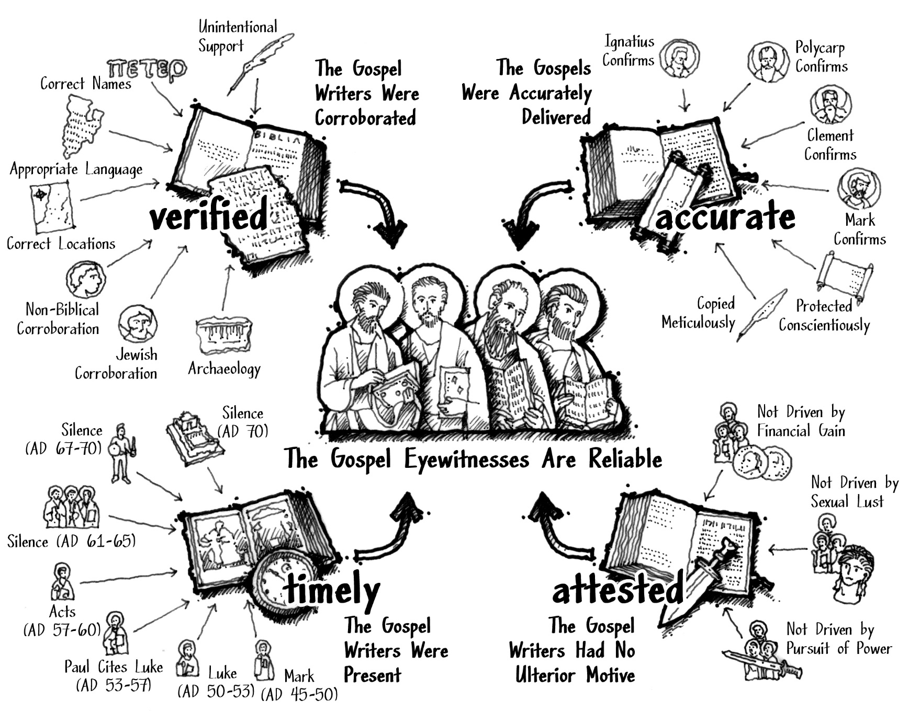
Notes:
This is where we are so far
-Verified: facts about ancient times were verified to be correct
-Accurate: the message of the gospels was consistent even through different time periods, cultures, and people
-Timely: Gospel writers were present when gospel accounts were written

Slide 51
for more information visit:
www.ColdCaseChristianity.com

